Slide 1
History of C programming
The C language was developed by Dennis Ritchie in 1970s at AT&T Bell laboratories.
Initially it was designed for programming in the operating system called UNIX.
After the advent of C, the whole UNIX is rewritten using it. Now almost the entire UNIX operating system and the tools supplied with it including the C complier itself are written in C.
The C language is derived from B language, which was written by ken Thompson at AT&T laboratories.
The B language was adopted from from a language called BCPL(Basic Combined Programming Language),which was developed by Martin Richards at Cambridge University.

Slide 2
Characteristics of C
C is a middle level language.
It has the simplicity of a high level language as well as the power of a low level language.
C language is consisting the 32 keywords.
C is a portable language.
C is a case sensitive.
In C language compilation and execution is faster.
C language is Extendible.
C is a structured language.

Slide 3
Compilation stages
Source code
Pre-processor
Expended code
Compiler
Assembly code
Assembler
Object code
Linker
Executable code

Slide 4
Preprocessor
The source code is the code which is written in a text editor and the source code file is given an extension ".c". This source code is first passed to the preprocessor, and then the preprocessor expands this code. After expanding the code, the expanded code is passed to the compiler.
Compiler
The expended code is passed to the compier. the machine converts this code into the machine’s assembly language code.
Assembler
This assembly language code is converted to object code by system,s assembler.
Linkerer
The linker combines this object code of the library functions with object code of our program.Therefore, we conclude that the job of the linker is to link the object code of our program with the object code of the library files and other files. The output of the linker is the executable file.

Slide 5
C Memory Layout
Higher address
Stack
Dynamic Memory
layout
Heap
Uninitialized data Segment
Static Memory
layout
Initialized data Segment
Text/Code segment
Lower address

Slide 6
Text segment
The text segment is also known as the code segment. When we compile any program, it creates an executable file like a.out, .exe, etc., that gets stored in the text or code section of the RAM memory.
Data section
The data which we use in our program will be stored in the data section. The variables declared in the data section could be stored in the form of initialized, uninitialized, and it could be local or global.
Therefore, the data section is divided into four categories, i.e.,
initialized.
uninitialized.
global.
local.

Slide 7
Example for Uninitialized and Initialized :-
#include<stdio.h>
int var1;
int var2 = 10;
void func()
{
printf("I am function");
}
int main()
{
func();
return 0;
}

Slide 8
Uninitialized data segment
The uninitialized data segment is also known as a .bss segment that stores all the uninitialized global, local and external variables.
If the global, static and external variables are not initialized, they are assigned with zero value by default.
The .bss segment stands for Block Started by symbol.
For example:-
#include<stdio.h>
char a; // uninitialized global variable.
int main()
{
static int a; // uninitialized static variable.
return 0;
}

Slide 9
Initialized data segment
An initialized data segment is also known as the data segment.
A data segment is a virtual address space of a program that contains all the global and static variables which are explicitly initialized by the programmer.
For example :-
#include<stdio.h>
char string[] = "Hello world"; // global variable stored in initialized data segment.
int main()
{
static int i = 90; // static variable stored in initialized data segment.
return 0;
}

Slide 10
Stack
When we define a function and call that function then we use the stack frame.
The variables which are declared inside the function are stored in the stack. The function arguments are also stored in the function as the arguments are also a part of the function.
The stack section plays a very important role in the memory because whenever the function is called, a new stack frame is created.
Heap
Heap memory is used for the dynamic memory allocation. Heap memory begins from the end of the uninitialized data segment and grows upwards to the higher addresses.
The malloc() and calloc() functions are used to allocate the memory in the heap.

Slide 11
Memory size and range of data types:
Data Types | Memory Size | Range
char | 1 byte | −128 to 127
signed char | 1 byte | −128 to 127
unsigned char | 1 byte | 0 to 255
short | 2 byte | −32,768 to 32,767
signed short | 2 byte | −32,768 to 32,767
unsigned short | 2 byte | 0 to 65,535
int | 2 byte | −32,768 to 32,767
signed int | 2 byte | −32,768 to 32,767

Slide 12
unsigned int | 2 byte | 0 to 65,535
short int | 2 byte | −32,768 to 32,767
signed short int | 2 byte | −32,768 to 32,767
unsigned short int | 2 byte | 0 to 65,535
long int | 4 byte | -2,147,483,648 to 2,147,483,647
signed long int | 4 byte | -2,147,483,648 to 2,147,483,647
unsigned long int | 4 byte | 0 to 4,294,967,295
float | 4 byte
double | 8 byte
long double | 10 byte

Slide 13
Tokens in C:
Tokens are the most important element to be used in creating a program in C. We can define the token as the smallest individual element in C.
For example, we cannot create a sentence without using words. similarly, we cannot create a program in C without using tokens in C.
Therefore, we can say that tokens in C is the building block or the basic component for creating a program in C language.
Classification of tokens in C
Keywords in C.
Identifiers in C.
Strings in C.
Operators in C.
Constant in C.
Special Characters in C.

Slide 14
printf() and scanf() in C
printf() function
The printf() function is used for output. It prints the given statement to the console.
The syntax of printf() function is given below:
printf("format string",argument_list)
The format string can be %d (integer), %c (character), %s (string), %f (float) etc.
scanf() function
The scanf() function is used for input. It reads the input data from the console.
The syntax of scanf() function is given below:
scanf("format string",argument_list);

Slide 15
Example for printf and scanf function.
Sum of two numbers
#include<stdio.h>
int main(){
int x=0,y=0,result=0;
printf("Enter first number:");
scanf("%d",&x);
printf("Enter second number:");
scanf("%d",&y);
result=x+y;
printf("Sum of 2 numbers:%d ",result);
return 0;
}
Output :-
Enter first number : 9
Enter second number : 9
Sum of 2 numbers : 18

Slide 16
Variables in C
A variable is a name of the memory location. It is used to store data. Its value can be changed, and it can be reused many times.
Let's see the syntax to declare a variable:
type variable_list;
Example of Declaring a variable:-
int a;
float b;
char c;
We can also provide values while declaring the variables as given below:
int a=10,b=20; //declaring 2 variable of integer type.
float f=20.8;
char c='A';

Slide 17
Rules for defining variables
A variable can have alphabets, digits, and underscore.
A variable name can start with the alphabet, and underscore only. It can't start with a digit.
No whitespace is allowed within the variable name.
A variable name must not be any reserved word or keyword, e.g. int, float, etc.
Types of Variables in C
1) Local Variable
A variable that is declared inside the function or block is called a local variable.
It must be declared at the start of the block.
void function1(){
int x=10; //local variable
}

Slide 18
Global Variable
A variable that is declared outside the function or block is called a global variable. Any function can change the value of the global variable. It is available to all the functions.
It must be declared at the start of the block.
int value=20; //global variable
void function1(){
int x=10; //local variable
}
Automatic Variable
All variables in C that are declared inside the block, are automatic variables by default. We can explicitly declare an automatic variable using auto keyword.
void main(){
int x=10; //local variable (also automatic)
auto int y=20; //automatic variable
}

Slide 19
Static Variable
A variable that is declared with the static keyword is called static variable.
It retains its value between multiple function calls.
void function1(){
int x=10; //local variable
static int y=10; //static variable
x=x+1;
y=y+1;
printf("%d,%d",x,y);
}
External Variable
We can share a variable in multiple C source files by using an external variable. To declare an external variable, you need to use extern keyword.
extern int x=10; //external variable (also global)

Slide 20
Data Types in C
A data type specifies the type of data that a variable can store such as integer, floating, character, etc.
There are different types of Data types.
DATA TYPES
BASIC
DERIVED
ENUMERATION
VOID

Slide 21
Types | Data Types
Basic Data Type | int, char, float, double
Derived Data Type | array, pointer, structure, union
Enumeration Data Type | enum
Void Data Type | void

Slide 22
Keywords in C
A keyword is a reserved word. You cannot use it as a variable name, constant name, etc. There are only 32 reserved words (keywords) in the C language.
A list of 32 keywords in the c language is given below:
auto | break | case | char | const | continue | default | do
double | else | enum | extern | float | for | goto | if
int | long | register | return | short | signed | sizeof | static
struct | switch | typedef | union | unsigned | void | volatile | while

Slide 23
C Identifiers
C identifiers represent the name in the C program, for example, variables, functions, arrays, structures, unions, labels, etc.
An identifier can be composed of letters such as uppercase, lowercase letters, underscore, digits, but the starting letter should be either an alphabet or an underscore.
Rules for constructing C identifiers
It should not begin with any numerical digit.
In identifiers, both uppercase and lowercase letters are distinct. Therefore, we can say that identifiers are case sensitive.
Commas or blank spaces cannot be specified within an identifier.
The length of the identifiers should not be more than 31 characters.
Identifiers should be written in such a way that it is meaningful, short, and easy to read.
some example :- total, sum, average, _m _, sum_1, etc.

Slide 24
Types of identifiers
Internal identifier
If the identifier is not used in the external linkage, then it is known as an internal identifier. The internal identifiers can be local variables.
External Identifier
If the identifier is used in the external linkage, then it is known as an external identifier. The external identifiers can be function names, global variables.
int main()
{
int a=10;
int A=20;
printf("Value of a is : %d",a);
printf("\nValue of A is :%d",A);
return 0;
}
Output :-
Value of a is : 10
Value of A is : 20

Slide 25
C Operators
An operator is simply a symbol that is used to perform operations.
Name of operators | Operators
Arithmetic operators | + , _ , * , / ,%
Increment/Decrement operators | ++ , -- ,
Relational operators | == , ! = , < = , > = , < , > ,
Logical operators | && , || , ! ,
Bitwise operators | & , ^ , | , ~ , >> , << ,
Assignment operators | = , += , - = , *= , /= , %= , <<= , >>= , &= , ^= , |= ,
Other operators | ?: & * sizeof() ,

Slide 26
Arithmetic operator
+ , - , * , / , %
All are binary operators = means two operands are required to perform operation.
For example :- A + B
#include<stdio.h>
int main()
{
int a=9, b=3; //declaring a and b
printf(“enter the first and second number \n”);
//scanf(“%d %d”, &a,&b); //accept input from the user
printf(“a / b =%d\n”, a/b);
printf(“a % b =%d\n”, a%b);
}
Output :-
a / b = 3
a % b = 0

Slide 27
Increment/Decrement operators
++ , -- ,
Increment operator :- It is used to increment the value of a variable by one.
Decrement operator :- It is used to decrement the value of a variable by one.
Increment and Decrement operators are unary operators.Because they are applied on single operand.
Example :-
a++,a--
Increment
int a = 5;
a++;
a = 6
Decrement
int a = 5;
a--;
a = 4

Slide 28
There are two types of increment operator
Pre-increment operator Post-increment operator
++a; a++;
There are two types of decrement operator
Pre-decrement operator Post-decrement operator
--a; a--;
pre – means first increment/decrement then assign it to another variable.
post – means first assign it to another variable then increment/decrement.

Slide 29
Relational operators
== , != , <= , >= , < , >
Relational operators they are used to comparing two values.
All Relational operators will return either True or False.
For example ;-
int a=300, b = 2090;
if ( b >= a )
{
printf(“Bingo! You are in”);
}
else
{
printf((“OOPS! You are out”);
}
Output :-
Bingo! You are in

Slide 30
Logical operators
&& , || , ! ,
&& and || are used to combine two conditions.
&& - returns TRUE when all the conditions under consideration are true and returns FALSE when any one or more than one condition is false.
For example :
#include<stdio.h>
int main(){
int a = 5;
if(a == 5 && a != 6 && a <= 56 && a > 4)
{
printf(“The codition is true“);
}}
True=1
False=0
Output :-
The codition is true

Slide 31
||-returns TRUE when one or more than one condition under consideration is true and returns FLASE when all conditions are false.
For example:
#include<stdio.h>
int main(){
if(a != 5 || a == 6 || a >= 56 || a > 4)
{
printf(“The codition is true“);
}
}
True=1
False=0
Output :-
The codition is true

Slide 32
! Operator is used to complement the condition under consideration.
!-returns TRUE when condition is FLASE and returns when condition is TRUE.
For example:
#include<stdio.h>
int main()
{
int a = 5;
if(!(a == 6))
{
printf (“Welcome to c programming“);
}
}
Output :-
Welcome to c programming

Slide 33
Bitwise operators
& , ^ , | , ~ , >> , << ,
Bitwise AND (&) operator
It takes two bits at a time and perform AND operation.
AND (&) is binary operator. It takes two numbers and perform bitwise AND.
Result of AND is 1 when both bits are 1
Truth table
0 1 1 1
& 0 1 0 0
4 0 1 0 0
A | B | A&B
0 | 0 | 0
0 | 1 | 0
1 | 0 | 0
1 | 1 | 1

Slide 34
Example for bitwise AND operator :-
#include <stdio.h>
int main()
{
int a=7, b=4; // variable declarations
printf("The output of the Bitwise AND operator a&b is %d",a&b);
return 0;
}
Output :-
The output of the Bitwise AND operator a&b is : 4

Slide 35
Bitwise OR (|) operator
It takes two bits at a time and perform OR operation.
OR (|) is binary operator. It takes two numbers and perform bitwise OR.
Result of OR is 0 when both bits are 0
Truth table
A | B | A|B
0 | 0 | 0
0 | 1 | 1
1 | 0 | 1
1 | 1 | 1
0 1 1 1
| 0 1 0 0
7 0 1 1 1

Slide 36
Example for bitwise OR operator :-
#include <stdio.h>
int main()
{
int a=7,b=4; // variable declarations
printf("The output of the Bitwise OR operator a|b is %d\n",a|b);
return 0;
}
Output :-
The output of the Bitwise OR operator a|b is : 7

Slide 37
Bitwise NOT (~) operator
NOT is a unary operator.
Its job is to complement each bit one by one.
Result of NOT is 0 when bits is 1 and 1 when bit is 0.
Truth table
A | ~A
0 | 1
1 | 0
~ 0 1 1 1
1 0 0 0

Slide 38
Example for bitwise NOT operator :-
#include <stdio.h>
int main()
{
int a=7; // variable declarations
printf("The output of the Bitwise complement operator ~a is %d\n",~a);
return 0;
}
Output :-
The output of the Bitwise complement operator ~a is : -8

Slide 39
Bitwise shift operators
Two types of bitwise shift operators exist in C programming.
The bitwise shift operators will shift the bits either on the left-side or right-side. Therefore, we can say that the bitwise shift operator is divided into two categories:
Left-shift operator
Right-shift operator
Bitwise Left shift(<<) operator
Left shift operator is binary operator and it require a two operand for perform a operation.
When bits are shifted left then trailing positions are filled with zeros.
First operand << Second operand
Whose bits get left shifted Decides the number of
places to shift the bits

Slide 40
Example for bitwise Left shift operator :-
#include <stdio.h>
int main()
{
int a=5; // variable initialization
printf("The value of a<<2 is : %d ", a<<2); //0101<<2=00010100
return 0;
}
Output :-
The value of a<<2 is : 20

Slide 41
Bitwise Right shift(>>) operator
Right shift operator is binary operator and it require a two operand for perform a operation.
When bits are shifted left then trailing positions are filled with zeros.
First operand << Second operand
Whose bits get left shifted Decides the number of
places to shift the bits

Slide 42
Example for bitwise Right shift operator :-
#include <stdio.h>
int main()
{
int a=7; // variable initialization
printf("The value of a>>2 is : %d ", a>>2); //0111>>2=0000 0001
return 0;
}
Output :-
The value of a>>2 is : 1

Slide 43
Bitwise XOR(^) operator
Bitwise XOR (^) is binary operator. It takes two numbers and perform bitwise XOR.
Result of XOR is 1 when two bits are different otherwise the result is 0.
Truth table
0 1 1 1
^ 0 1 0 0
3 0 0 1 1
A | B | A^B
0 | 0 | 0
0 | 1 | 1
1 | 0 | 1
1 | 1 | 0

Slide 44
Example for bitwise XOR operator :-
#include <stdio.h>
int main()
{
int a=7,b=4; // variable declarations
printf("The output of the Bitwise XOR operator a|b is %d\n",a^b);
return 0;
}
Output :-
The output of the Bitwise XOR operator a|b is 3

Slide 45
Assignment operators
= , += , - = , *= , /= , %= , <<= , >>= , &= , ^= , |= ,
Assignment operator is an operator which is used to assigned value to variable.
Assignment operator is a binary operator.
= Operator
This is a simple Assignment Operator.
For example :-
#include <stdio.h>
void main() {
int x = 10;
int y = x; // y will becomes x
printf("x = %d\n" , x); // x = ?
printf("y = %d\n" , y); // y = ?
}
Output :-
X = 10
y = 10

Slide 46
+= Operator
This is the Addition Assignment Operator.
In which the left operand becomes equal to the addition of the right operand and left operand.
-= Operator
This is the Subtraction Assignment Operator.
In which left operand becomes equal to the subtraction of right operator from left operand.
*= Operator
The main purpose of this operator is that this left operand becomes equal to the product of the left and right operand. This is the Multiplication Assignment Operator.

Slide 47
/= Operator
This one is Division Assignment Operator.
In this, the left operand becomes equal to the division of the left and right operand.
%= Operator
It is well known Modulus Assignment Operator.
In this , left operand becomes equal to the modulo of left and right operand.
<<= Operator
This is called the Left Shift Assignment Operator.
For example x <<= y so in this, x becomes equal to x left shifted by y.

Slide 48
>>= Operator
This is called the Right Shift Assignment Operator.
For example x >>= y so , x becomes equal to x right shifted by y.
&= Operator
This operator is called the Bitwise AND Assignment Operator.
Left operand becomes equal to the bitwise AND of left and right operand.
^= Operator
This is called the Bitwise Exclusive OR Assignment Operator
Left operand becomes equal to bitwise XOR of left and right operand.

Slide 49
Example for assignment operators :-
#include<stdio.h>
int main()
{
int x=21;
int c;
c = x;
printf("= operator result is :%d\n",c);
c += x;
printf("+= Operator result is : %d\n",c);
c -= x;
printf("-= Operator result is : %d\n",c);
c *= x;
printf("*= Operator result is : %d\n",c);
c /= x;
printf("/= Operator result is : %d\n",c);
c=200;
c %= x;
printf("%%= Operator result is : %d\n",c);
c <<= 2;
printf("<<= Operator result is : %d\n",c);
c >>= 2;
printf(">>= Operator result is : %d\n",c);
c &= 2;
printf("&= Operator result is : %d\n",c);
c ^= 2;
printf("^= Operator result is : %d\n",c);
c |= 2;
printf("|= operator result is : %d\n",c);
}

Slide 50
Output
= operator result is :21
+= Operator result is : 42
-= Operator result is : 21
*= Operator result is : 441
/= Operator result is : 21
%= Operator result is : 11
<<= Operator result is : 44
>>= Operator result is : 11
&= Operator result is : 2
^= Operator result is : 0
|= operator result is : 2

Slide 51
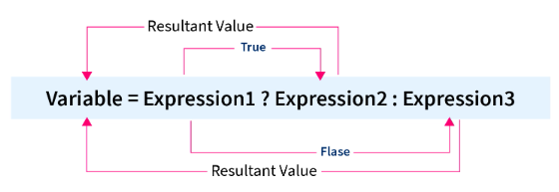
Conditional Operator in C
? :
The conditional operator is also known as a ternary operator.
The conditional statements are the decision-making statements which depends upon the output of the expression. It is represented by two symbols, i.e., '?' and ':'.
Syntax of a conditional operator :- Expression1? Expression2: Expression3;

Slide 52
Examples of the Conditional operator in C
#include <stdio.h>
int main() {
int num;
printf(“emnter the any number”);
scanf("%d", &num);
(num % 2 == 0)? printf("The given number is even") : printf("The given number is odd");
return 0;
}
Output :-
enter the any number :-
45
The given number is odd

Slide 53
Comma operators in C
,
To separate two or more expressions we use the comma operator in C.
Where expression1 is evaluated first, and after that expression2, and the value of expression2 is returned for the entire expression.
Comma as an Operator
When we want to assign multiple numbers of values to any variable in a program, we use the comma in the form of an operator.
#include<stdio.h>
int main()
{
int x;
int a = (x=2,x+4);
printf("%d", a);
return 0;
}
Output :-
6

Slide 54
Comma as a Separator
The comma operator in C can be used as a separator (multiple definitions in a single line) in the program whenever we want to declare multiple variables and provide different parameters in the function.
#include <stdio.h>
int main() {
int a = 10, b = 20, c = 30;
printf("%d %d %d", a, b, c);
return 0;
}
Output :-
10 20 30

Slide 55
Comments in C
Comments in C language are used to provide information about lines of code. It is widely used for documenting code. There are 2 types of comments in the C language.
Single Line Comments
Multi-Line Comments
Single Line Comments
Single line comments are represented by double slash \\.
For example :-
#include<stdio.h>
int main(){
//printing information
printf("Hello C");
return 0;
}
Output :-
Hello C

Slide 56
Multi Line Comments
Multi-Line comments are represented by slash asterisk \* ... *\. It can occupy many lines of code, but it can't be nested.
For example :-
#include<stdio.h>
int main(){
/*printing information
Multi-Line Comment*/
printf("Hello C");
return 0;
}
Output :-
Hello C

Slide 57
Control statements in C
The control statements in C help the computer to execute a certain logical statement and decide whether to enable the control of the flow through a certain set of statements or not.
And also these are used to direct the execution of statements under certain conditions.
Control Statements
Decision control statements.
Iterative control statements.
Jumping control statements
if
while
break
if else
for
Nested if else
do while
continue
switch

Slide 58
1.Decision Control Statements:
1.if statement:
An if statement consist of an Expression followed by one or more statements .
Flowchart:
Start
Syntax:
if (expression/Condition)
{
statements; //will execute if the expression is true.
}
Condition
True
statements
False
End
If the entered expression/Condition is validated to true, then block of code inside the if is going to execute.
If the entered expression/Condition is validated to false, then first set of code after the end of the if statement is going to execute.
The C language assumes that any non zero or non null values are true value, and if it is either zero or null then it is false value.

Slide 59
Example:
#include <stdio.h>
int main ()
{
int a = 10; // local variable definition
if( a < 20 ) // check the condition using if statement
{
printf("a is less than 20\n" ); //if condition is true then print the following
}
printf("value of a is : %d\n", a);
return 0;
}
Output:
a is less than 20
value of a is : 10

Slide 60
2.if-else statement:
In if-else statement an if statement can be followed by an optional else statement ,which executes only when the expression or condition is false.
Syntax:
Flowchart:
Start
if (expression/Condition)
{
statements; //will execute if the expression is true.
}
else
{
statements; //will execute if the expression is false.
}
Condition
True
Condition Code
if Code
False
else Code
End
If the entered expression or condition is validated to true , then the if block will be executed, otherwise the else block will be executed.

Slide 61
Example:
#include <stdio.h>
int main ()
{
int a = 100; // local variable definition
if( a < 20 ) //check the Boolean condition
{
printf("a is less than 20\n" ); //if condition is true then print the following
}
else
{
printf("a is not less than 20\n" ); //if condition is false then print the following
}
printf("value of a is : %d\n", a);
return 0;
}
Output:
a is not less than 20
value of a is : 100

Slide 62
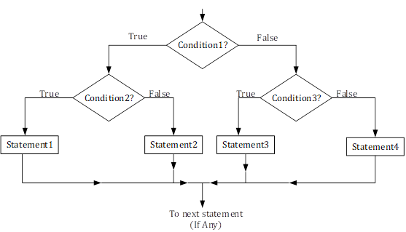
3.Nested if else statement:
The C language gives the permission to nest if-else statements, means that we can use one if or else if statement inside another if or else if statements.
Syntax:
if (expression/Condition 1)
{
if (expression/Condition 2)
{
statement 1;
}
else
{
statement 2;
}
else
{
if(condition 3)
{
statement 3;
}
else{
Statement 4;
}
}
Flowchart:

Slide 63

Example:
#include<stdio.h>
int main()
{
int num1, num2, num3;
printf("Enter three numbers:\n");
scanf("%d%d%d",&num1, &num2, &num3);
if(num1>num2)
{
if(num1>num3) //This is nested if-else
{
printf("Largest = %d", num1);
}
else
{
printf("Largest = %d", num3);
}
}
else
{
if(num2>num3) / /This is nested if-else
{
printf("Largest = %d", num2);
}
else
{
printf("Largest = %d", num3);
}
}
return(0);
}
Enter three numbers:
200
18
29
Largest = 200

Slide 64
4.switch statement:
switch statement allows a variable to be tested for equality against a list of values. Each value is called as a case, and the variable being switched on is checked for each switch case.
Syntax:
Flowchart:
switch(expression)
{
case ‘constant expression’:
statement(s);
break;
case ‘constant expression’:
statement(s);
break;
//you can have any number of cases
default :
statement(s);
}
Start
Switch expression
Case 1
True
Statement 1
False
Case 2
True
Statement 2
False
Case N
True
Statement N
False
Default statement
End

Slide 65
Rules and working of switch statement:
The expression used in switch must be an integral or enumerated type.
We can use any number of case statements within a switch. Each case is followed by the value to be compared to and a colon.
The constant expression for a case must be the same data types as the variable in the switch, and it must be constant or a literal.
In switch case when the variable is equal to a case, then statement following that case will execute until it reaches the break statement.
After break statement is reached the switch terminates and flow of control jumps to next line following the switch statements.
Not every case needs to contain a break. If no break appears, the flow of control will fall through to subsequent cases until a break is reached.
A switch statement can have an optional default case, which must appear at the end of the switch. The default case can be used for performing a task when none of the cases is true. No break is needed in the default case

Slide 66

#include <stdio.h>
int main()
{
int week; //Declare integer variable to store week number
printf("Enter day number of week (1-7): "); //Input week number from user
scanf("%d", &week);
switch(week)
{
case 1:
printf("Its Monday.\n"); //If day == 1
printf("Its a busy day.");
break;
case 2:
printf("Its Tuesday."); //If day == 2
break;
case 3:
printf("Its Wednesday."); //If day == 3
break;
case 4:
printf("Its Thursday.\n"); //If day == 4
printf("Feeling bit relaxed.");
break;
case 5:
printf("Its Friday."); //If day == 5
break;
case 6:
printf("Its Saturday.\n"); //If day == 6
printf("It is weekend.");
break;
case 7:
printf("Its Sunday.\n"); //If day == 7
printf("Hurray! Its holiday.");
break;
default:
printf("Um! Please enter day number between 1-7."); //If day 1 to 7
}
return 0;
}
Enter day number of week (1-7): 7
Its Sunday.
Hurray! Its holiday.
Enter day number of week (1-7): 4
Its Thursday.
Feeling bit relaxed.

Slide 67
2.Iterative control statements.
LOOPS in C
Loops are also called as Iterative statements.
Loops are used in c because
These provides code reusability.
Using loops we do not need to write the same code again and again.
Using loops we can traverse over the elements of data structures.(array or linked lists)
There are 3 loops in C;
1.while loop,
2.for loop.
3.do while loop.

Slide 68
1.While loop:
The while loop in C will repeatedly executes the target statement as long as the entered condition is true.
Syntax:
Flowchart:
Start
While(condition)
{
Statement(s);
}
Condition
False
True
Code block
End
Here, statement(s) may be of single statement or are of block statements. The condition may be any expression, and true is any nonzero value. The loop iterates while the condition is true.
When the condition becomes false, the program control passes to the line immediately following the loop.

Slide 69
Example:
#include <stdio.h>
int main ()
{
int a = 10; //local variable definition
while( a < 20 ) //while loop execution
{
printf("value of a: %d\n", a);
a++;
}
return 0;
}
value of a: 10
value of a: 11
value of a: 12
value of a: 13
value of a: 14
value of a: 15
value of a: 16
value of a: 17
value of a: 18
value of a: 19

Slide 70
2.for loop:
A for loop is a repetition control structure that allows you to efficiently write a loop that needs to execute a specific number of times.
Syntax:
Flowchart:
for(init ; condition ; increment)
{
statement(s);
}
Start
init
The init step is executed first, and only once. This step allows you to declare and initialize any loop control variables. You are not required to put a statement here, as long as a semicolon appears.
Next, the condition is evaluated. If it is true, the body of the loop is executed. If it is false, the body of the loop does not execute and the flow of control jumps to the next statement just after the 'for' loop.
After the body of the 'for' loop executes, the flow of control jumps back up to the increment statement. This statement allows you to update any loop control variables. This statement can be left blank, as long as a semicolon appears after the condition.
The condition is now evaluated again. If it is true, the loop executes and the process repeats itself (body of loop, then increment step, and then again condition). After the condition becomes false, the 'for' loop terminates.
Condition
False
True
Code block
increment
End

Slide 71
Example:
first 10 natural numbers are:
1
2
3
4
5
6
7
8
9
10
#include <stdio.h>
int main ()
{
int i; //local variable definition
printf("first 10 natural numbers are:\n");
for( i =1; i<=10; i++ ) //for loop execution
{
printf("%d\n",i);
}
return 0;
}

Slide 72
3.do-while loop:
In previous two loops unlike for and while loops, do while loop check the condition at the bottom of the loop.
The do-while loop is same as while loop except the fact that its guaranteed to execute at least one time.
Syntax:
Flowchart:
do
{
Statement(s);
}
while(condition);
Start
Code block
Condition
Look up to flowchart that the conditional expression appears at the end of the loop, so whatever statement or expression are present are executes once before the condition is tested.
If the conditional expression is true then the again flow control jumps to do, and executes statements until the expression becomes false.
True
False
End

Slide 73
Example:
#include<stdio.h>
int main()
{
int i=1; //local variable definition
do //do while loop execution
{
printf("%d \t",i);
i++;
}
while(i<=10);
return 0;
}
1 2 3 4 5 6 7 8 9 10

Slide 74
3.Jumping control statements:
1.break:
The break used in C has following advantages:
Whenever the break is encountered inside a loop the loop is immediately terminated and the control resumes at the next statement following the loop.
It can be used to terminate a case in the switch statement.
If suppose we are using nested loops, and the break statement will stop the execution of the innermost loop and start executing the next line of code after the block.
Flowchart:
Syntax:
Start
break;
Conditional Code
True
Condition
break
False
End

Slide 75
Example:
#include <stdio.h>
int main ()
{
int a = 10; //local variable definition
while( a < 20 ) //while loop execution
{
printf("value of a: %d\n", a);
a++;
if( a > 15)
{
break; //terminate the loop using break statement
}
}
return 0;
}
value of a: 10
value of a: 11
value of a: 12
value of a: 13
value of a: 14
value of a: 15

Slide 76
2.continue:
The continue statement in C programming works same as like the break statement. Difference is Instead of forcing termination, it forces the next iteration of the loop to take place, skips any code in between.
For the for loop, continue statement causes the conditional test and increment portions of the loop to execute.
For the while and do...while loops, continue statement causes the program control to pass to the conditional tests.
Syntax:
Flowchart:
Start
continue;
Conditional Code
True
Condition
continue
False
End

Slide 77
Example:
#include <stdio.h>
int main ()
{
int a = 10; //local variable definition
do
{ //do loop execution
if( a == 15)
{
a = a + 1; //skip the iteration
continue;
}
printf("value of a: %d\n", a);
a++;
} while( a < 20 );
return 0;
}
value of a: 10
value of a: 11
value of a: 12
value of a: 13
value of a: 14
value of a: 16
value of a: 17
value of a: 18
value of a: 19
You can see in output 15 is not printed it got skipped and further loop continued.

Slide 78
FUNCTIONS

Slide 79
Presentation Includes :
Introduction to functions
Types of C functions
Function naming rule in c
Three main parts of function
Categorized based on argument and return value
Passing arguments
Advantage of function
Recursive function
Macro’s in C

Slide 80
Introduction :
Function are used for divide a large code into module, due to this we can easily debug and maintain the code.
A function is a block of code which only runs when it is called. You can pass data, known as parameters, into a function.
Functions are used to perform certain actions, and they are important for reusing code: Define the code once, and use it many times.
Depending on whether a function is defined by the user or already included in C compilers, There Are Two Types Of Functions In C Programming
1.Standard library functions or pre-define function
2.User defined functions

Slide 81
Functions
Library Functions
User Defined Functions
Predefined
Created by user
Declarations inside header files
Reduced complexity of program
Eg: Printf () , scanf(0..etc

Slide 82
Function naming rule in c
A function name must begin with an alphabetic letter or the underscore _ character, but the other characters in the name can be chosen from the following groups:
Any lower-case letter from a to z
Any upper-case letter from A to Z
Any digit from 0 to 9
The underscore character
The general form of a function definition in C
return_data_type function_name(parameter list)
{
// body of the function
}

Slide 83
Parts of user-defined function in C
Function declaration return_Type function_Name(parameter1,parameter2,......);
function call function_Name(Argument list);
Function definition return_Type function_name(parameter_1, parameter_2,....)
{
//body of the function
}
Types of the user-defined function in C language
function with a return value and with an argument
function with a return value and without argument
function with no return value and with an argument
function with no return value and without argument

Slide 84
1.function with a return value and with an argument
#include<stdio.h>
int add( int , int ) ; //function declaration
int main( )
{
int a = 5 , b = 10 , result ;
result = add( a , b ) ; //function call and actual argument these are
printf( "%d" , result) ;
}
int add( int a , int b ) //function definition
{
int c ;
c = a + b ; //These are formal parameter
return c ;
}
Output :-
5

Slide 85
2.function with a return value and without an argument
#include<stdio.h>
int add( ) ;
int main( )
{
int result ;
result = add( ) ;
printf( "%d" , result ) ;
}
int add( )
{
int a = 5 , b = 10 , c ; //no argument passing so declare and initilize here only
c = a + b ;
return c ;
}
Output :-
15

Slide 86
3.function without a return value and with an argument
#include<stdio.h>
void add( int a , int b) ; //variable name is optional to written
int main( )
{
int a = 5 , b = 10 , result ;
add( a , b ) ;
}
void add( int a , int b )
{
int c ;
c = a + b ;
printf( "%d" , c ) ;
}
Output :-
15

Slide 87
4.function without a return value and without an argument
#include<stdio.h>
void add( ) ;
int main( )
{
add( ) ; //function call
}
void add( )
{
int a = 5 , b = 10 , c ; //without return type and no argument pass
c = a + b ;
printf( "%d" , c ) ; //without return type so printf in userdefined function only
}
Output :-
15

Slide 88
There are two methods to pass the data into the function in C language
1.Call by value
2.Call by reference.
Call by value in C
In call by value method, the value of the actual parameters is copied into the formal parameters. In other words, we can say that the value of the variable is used in the function call in the call by value method.
In call by value method, we can not modify the value of the actual parameter by the formal parameter.
In call by value, different memory is allocated for actual and formal parameters since the value of the actual parameter is copied into the formal parameter.
The actual parameter is the argument which is used in the function call whereas formal parameter is the argument which is used in the function definition.

Slide 89
Call By Value Flow Chart
Start
Read A
Read B
Swap(A,B)
Swap(int a , int b)
End
Temp =a
a=b
b=temp
Printf a
Printf b
Return

Slide 90
Swap two number using call by value
#include<stdio.h>
void swap( int , int ) ;
int main( ) {
int a = 10 , b = 20 ;
printf("Before swap :a=%d\tb=%d\n",a,b);
swap( a , b ) ;
}
void swap(int a , int b)
{
int temp ;
temp = a ;
a = b ;
b = temp ;
printf("After swap:a=%d\tb=%d" , a , b ) ;
}
Output :-
Before swapping : 10 20
After swapping : 20 10

Slide 91
Call by reference in C
In call by reference, the address of the variable is passed into the function call as the actual parameter.
The value of the actual parameters can be modified by changing the formal parameters since the address of the actual parameters is passed.
In call by reference, the memory allocation is similar for both formal parameters and actual parameters. All the operations in the function are performed on the value stored at the address of the actual parameters, and the modified value gets stored at the same address.

Slide 92
Call by referance flow chart
Start
int *p,*q
p=&a
q=&b
Read p
Read q
Swap(int *a , int *b)
Temp =a
a=b
b=temp
Swap(p,q)
End
Printf a
Print b
Return

Slide 93
Swap two number using call by referance
#include<stdio.h>
void swap( int * , int * ) ;
int main( )
{
int a = 5 , b = 10 ;
printf("before swap a=%d\tb=%d\n",a,b);
swap(&a , &b) ;
}
void swap(int *a , int *b)
{
int temp;
temp = *a ;
*a = *b ;
*b = temp ;
printf("%d\t%d\n" , &a , &b) ;
printf("after swap a=%d\tb=%d" , *a , *b) ;
}
Output :-
Before swapping : 5 10
After swapping : 10 5

Slide 94
Passing array as arguments in functions
#include<stdio.h>
int sum(int a[]); //function definition
int main()
{
int a[ ] = { 2 , 3 , 5 , 6 } , result ;
result = sum( a ) ; //function call
printf( "%d" , result ) ;
}
int sum( int a[ ] ) //function definition with return type and with argument
{
int sum = 0 , i ;
for(i=0 ; i<4 ; i++)
{
sum=sum + a[ i ];
}
return sum ;
}
Output :-
16

Slide 95
Passing structure as an arguments in function
#include<stdio.h>
struct student
{
char name[ 20 ] ;
int age , per ;
} s1 ; //structure variable declaration
int main( )
{
gets(s1.name) ;
scanf( "%d %d" , &s1.age , &s1.per ) ; //age and percentage taking as input
display(s1.age , s1.per) ; //call function
}
void display( int a , int b ) //function definiion
{
printf( "age:%d\n per : %d " , a , b) ;
}
Output :-
umesh
22
85
age:22
per : 85

Slide 96
Passing pointer as an arguments in function
#include<stdio.h>
int main( )
{
int sallery , bonus , a ;
printf("enter sallery:") ;
scanf("%d",&sallery) ;
printf("enter bonus:") ;
scanf("%d",&bonus) ;
a = hike(&sallery,&bonus) ; //function calling
printf("total sallery:%d",a) ;
}
int hike(int *sallery , int *bonus) //with return type and with argument
{
return *sallery + *bonus ;
}
Output :-
enter sallery:10000
enter bonus:2000
total sallery:12000

Slide 97
Passing string as an arguments in function
#include<stdio.h>
int main( )
{
char a[ 20 ] = "Brigosha" ;
fun( a ) ;
}
void fun(char *p)
{
printf( "%s" , p ) ;
}
Output :-
Brigosha

Slide 98
Advantages of Using Functions in C Programming
It will reduce the time complexity
One of the primary achievements of the C functions is reusability.
we can call a function any place in program
can easily correct or debug the program
We can perform the tracking of a large C program pretty easily if we divide it into various functions.

Slide 99
Recursion and Macros

Slide 100
Introduction
Recursion is the process which comes into existence when a function calls a copy of itself to work on a smaller problem. Any function which calls itself is called recursive function, and such function calls are called recursive calls.
Recursion involves several numbers of recursive calls. However, it is important to impose a termination condition of recursion.
Recursion cannot be applied to all the problem, but it is more useful for the tasks that can be defined in terms of similar subtasks. For Example, recursion may be applied to sorting, searching, and traversal problems.

Slide 101
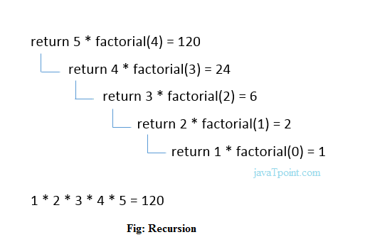
Example 1:
Calculate the factorial of a number using recursion
#include <stdio.h>
int fact (int);
int main()
{
int n,f;
printf("Enter the number whose factorial you want to calculate?");
scanf("%d",&n);
f = fact(n);
printf("factorial = %d",f);
}
int fact(int n)
{
if (n==0)
{
return 0;
}
else if ( n == 1)
{
return 1;
}
else
{
return n*fact(n-1);
}
}

Slide 102
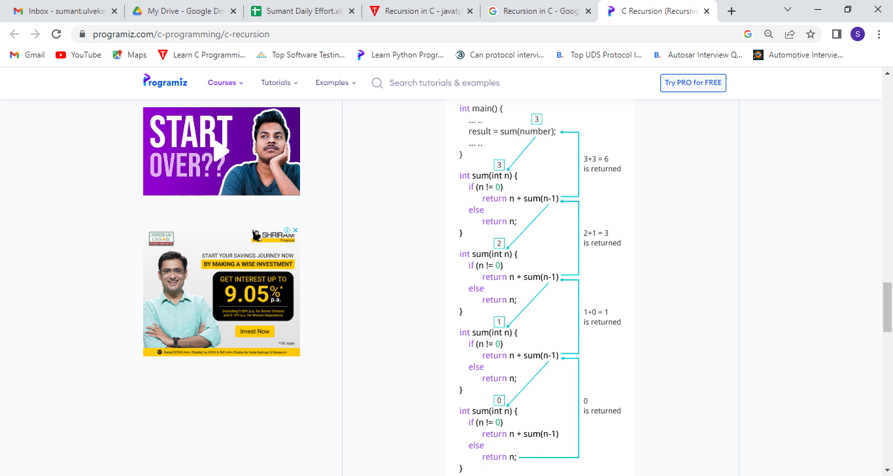
Example 2
Sum of Natural Numbers Using Recursion
#include <stdio.h>
int sum(int n);
int main( )
{
int number, result ;
printf("Enter a positive integer :");
scanf("%d", &number) ;
result = sum(number) ;
printf("sum = %d", result) ;
return 0 ;
}
int sum(int n)
{
if (n != 0)
// sum() function calls itself
return n + sum(n-1) ;
else
return n ;
}

Slide 103
Types of the recursion
1.Direct Recursion
When a function calls itself within the same function repeatedly, it is called the direct recursion.
fun( )
{
// write some code
fun( );
// some code
}

Slide 104
Example
#include<stdio.h>
int fibo_num (int i)
{
if ( i == 0)
{
return 0; // if the num i is equal to 0, return 0;
}
if ( i == 1)
{
return 1;
}
return fibo_num (i - 1) + fibonacci (i -2);
}
int main ( )
{
int i;
for ( i = 0; i < 10; i++) // use for loop to get the first 10 fibonacci series
{
printf (" %d \t ", fibo_num (i) ) ;
}
return 0;
}
Output :-
0 1 1 2 3 5 8 13 21 34

Slide 105
2.Indirect Recursion
When a function is mutually called by another function in a circular manner, the function is called an indirect recursion function.
fun1()
{
// write some code
fun2()
}
fun2()
{
// write some code
fun3()
// write some code
}
fun3()
{
// write some code
fun1()
}

Slide 106
Example
#include <stdio.h>
// declaration of the odd and even() function
void odd(); // Add 1 when the function is odd()
void even(); // Subtract 1 when the function is even
int num = 1; // global variable
void odd ()
{
// if statement check and execute the block till n is less than equal to 10
if (num <= 10)
{
printf (" %d ", num + 1); // print a number by adding 1
num++; // increment by 1
even(); // invoke the even function
}
return;
}
void even ()
{
// if block check the condition that n is less than equal to 10
if ( num <= 10)
{
printf (" %d ", num - 1); // print a number by subtracting 1
num++;
odd(); // call the odd() function
}
return;
}
int main ()
{
odd(); // main call the odd() function at once
return 0;
}
Output :-
2 1 4 3 6 5 8 7 10 9

Slide 107
3.Tail Recursion
A recursive function is called the tail-recursive if the function makes recursive calling itself, and that recursive call is the last statement executes by the function. After that, there is no function or statement is left to call the recursive function.

Slide 108
Example
#include <stdio.h>
void fun1( int num) // function definition
{
if (num = = 0) // if block check the condition
return;
else
printf ("\n Number is: %d", num); // print the number
return fun1 (num - 1); // recursive call at the end in the fun() function
}
int main ()
{
fun1(7); // pass 7 as integer argument
return 0; Number is: 7
}
Output :-
Number is: 6
Number is: 5
Number is: 4
Number is: 3
Number is: 2
Number is: 1

Slide 109
4.Non-Tail / Head Recursion
A function is called the non-tail or head recursive if a function makes a recursive call itself, the recursive call will be the first statement in the function. It means there should be no statement or operation is called before the recursive calls.
Furthermore, the head recursive does not perform any operation at the time of recursive calling. Instead, all operations are done at the return time.

Slide 110
Example
#include <stdio.h>
void head_fun (int num)
{
if ( num > 0 )
{
// Here the head_fun() is the first statement to be called
head_fun (num -1);
printf (" %d", num);
}
}
int main ()
{
int a = 5;
printf (" Use of Non-Tail/Head Recursive function \n");
head_fun (a); // function calling
return 0;
}
Output :-
Use of Non-Tail/Head Recursive function
1 2 3 4 5

Slide 111
C Macros
A macro is a segment of code which is replaced by the value of macro. Macro is defined by #define directive.
There are two types of macros:
Object-like Macros
Function-like Macros

Slide 112
1.Object-like Macros
The object-like macro is an identifier that is replaced by value. It is widely used to represent numeric constants.
For example: #define PI 3.14
Here, PI is the macro name which will be replaced by the value 3.14.

Slide 113
Example
#include <stdio.h>
#define SIDE 4
int main() {
int area;
area = SIDE*SIDE;
printf("Object Like Macros!\n");
printf("Area is: %d",area);
return 0;
}
Output :-
Object Like Macros!
Area is: 16

Slide 114
2.Function-like Macros
The function-like macro looks like function call. For example:
#define MIN(a,b) ((a)<(b)?(a):(b))
Here, MIN is the macro name.

Slide 115
Example
#include <stdio.h>
#define AREA(s) (s * s) // macro with argument
int main()
{
int s1 = 10, area_of_square;
area_of_square = AREA(s1);
printf("Macros with arguments!\n");
printf("Area of square is: %d", area_of_square);
return 0;
}
Output :-
Macros with arguments!
Area of square is: 100

Slide 116
C Predefined Macros
No. | Macro | Description
1 | _DATE_ | represents current date in "MMM DD YYYY" format.
2 | _TIME_ | represents current time in "HH:MM:SS" format.
3 | _FILE_ | represents current file name.
4 | _LINE_ | represents current line number.
5 | _STDC_ | It is defined as 1 when compiler complies with the ANSI standard.

Slide 117
Example
#include<stdio.h>
int main( )
{
printf("File :%s\n", __FILE__ ) ;
printf("Date :%s\n", __DATE__ ) ;
printf("Time :%s\n", __TIME__ ) ;
printf("Line :%d\n", __LINE__ ) ;
printf("STDC :%d\n", __STDC__ ) ;
return 0;
}
Output :-
File :C:\Users\Brigosha_Guest\Desktop\P\q.c
Date :Mar 25 2023
Time :12:57:50
Line :7
STDC :1

Slide 118
Array
Definition of Array
Why Array is used
Types of Array
One Dimensional Array
Declaration of 1-D Array
Accessing 1-D Array Elements
Processing 1-D Array
Initialization of 1-D Array
1-D Array and Functions
Passing Individual Array Element to Function
Passing whole 1-D Array to a Function

Slide 119
Two Dimensional Array
Declaration and Accessing Individual Elements of 2-DArray
Processing of 2-D Array
Initialization of 2-D Arrays
Arrays with more than Two Dimensions
Multidimensional Array and Functions

Slide 120
ARRAY
An Array is a data structure containing a number of data values all of which are same type.Data structure is a format for organizing and storing data.
Array is data structure which you can visualize as follows:
imagine an array as a large chunk of memory divided into smaller block of memory and each block is capable of storing a data value of some type.

Slide 121
Why Array is Used
The variables that we have used till now are capable of storing only one value at a time. Consider a situation when we want to store and display the age of 100 employees. We can do the following
➢Declare 100 different variables to store the age of employees.
➢Assign a value to each variable.
➢Display the value of each variable.
We can do the above steps, but it would be difficult to handle so many variables in the program and the program would become very lengthy. The concept of arrays is used in these types of situations where we can group similar type of data items.

Slide 122
TYPES OF ARRAY
There are Three types of Array. They are
➢One Dimensional Array
➢Two Dimensional Array
➢Multi Dimensional Array

Slide 123
ONE DIMENSIONAL ARRAY
Declaration of 1-D Array
The simplest form of array one can imagine is One Dimensional array. Like other simple variables, arrays should also be declared before they are used in the program. The syntax for declaration of an array is-
data_type array_name[size];

Slide 124
Here array_name denotes the name of the array and it can be any valid C identifier, data_type is the data type of the elements of array. The size of the array specifies the number of elements that can be stored in the array. Here are some examples of array declarations
int age[100];
float salary [15];
char grade[20];
Here age is an array of type int, which can store 100 elements of type int. The array salary is a float type array of size 15, can hold values of type float and third one is a character type array of size 20, can hold characters.

Slide 125
Accessing 1-D Array Elements
The elements of an array can be accessed by specifying the array name followed by subscript in brackets. In C the array subscript start from 0. Hence if there is an array of size, the valid subscripts is one less than the size of the array. Let us take an array.
int arr[5]; /*size of array arr is 5, can hold five integer elements*/
The elements of this array are
arr[0], arr[1], arr[2], arr[3]
Here 0 is the lower bound and 4 is the upper bound of the array.

Slide 126
Processing 1-D Array
For processing arrays we generally use a for loop and the loop variable is used at the place of subscript. The initial value of loop variable is taken 0 since array subscripts start from zero. The loop variable is increased by 1 each time so that we can access and process the next element in the array.
Reading values in arr
for(i=0; i<10; i++)
scanf(“%d”,&arr[i]);
Displaying values of arr
for(i=0; i<10; i++)
Printf(“%d”,arr[i]);
➢Adding all the elements of arr
sum=0;
for(i=0; i<10; i++)
Sum+=arr[i];

Slide 127
Initialization of 1-D Array
After declaration, the elements of a local array have garbage value while the elements of global and static arrays are automatically initialized to zero. We can explicitly initialize arrays at the time of declaration. The syntax for initialization of an Array is
data_type array_name[size]={value1, value2, ....valueN};
Here array_name is the name of the array variable, size is the size of array and value1,value2....valueN are the constant value known as initializers, which are assigned to the array elements one after another.
Example:
int a[5]={1, 11, 6, 3, 9};

Slide 128
Example 1:
Program to input values into an array and display them
#include <stdio.h>
int main()
{
int a[1000],i,n;
printf("Enter size of array: ");
scanf("%d",&n);
printf("Enter %d elements in the array : ", n);
for(i=0;i<n;i++)
{
scanf("%d", &a[i]);
}

Slide 129
printf("\nElements in array are: ");
for(i=0;i<n;i++)
{
printf("%d ", a[i]);
}
return 0;
}
Output:
Enter size of array 5
Enter 5 elements in array 1
2
3
4
5
Elements in array are: 1 2 3 4 5

Slide 130
1-D Arrays and Functions
Passing Individual Array Elements to a Function
In C programming, you can pass an entire array to functions. Before we learn that, let's see how you can pass individual elements of an array to functions.
We know that an array element is treated as any other simple variable in the program. So like other simple variables, we can pass individual array elements as arguments to a function.

Slide 131
Example 2:
Program to pass array elements to a function
#include <stdio.h>
void check(int num);
int main()
{
int arr[10],i;
printf("Enter the Array elements ");
for(i=0;i<10;i++)
{
scanf("%d",&arr[i]);
check(arr[i]);
}

Slide 132
return 0;
}
void check(int num){
if(num%2==0)
printf("%d is even\n",num);
else
printf("%d is odd\n",num);
}
Output:
Enter the Array elements
5
5 is odd
6
6 is even

Slide 133
Passing whole 1-D Array to a Function
We can pass whole array as an actual argument to a function. The corresponding formal argument should be declared as an array variable of the same data type.
Syntax:
int main()
{
int arr[10];
.....
.....
func(arr);
return 0;
}

Slide 134
func(int val[10])
{
....
....
}
It is optional to specify the size of the array in the formal argument, for example we may write the function definition as-
func(int val[])
{
....
....
}

Slide 135
TWO DIMENSIONAL ARRAY
Declaration and Accessing Individual Elements of a 2-D Array
The syntax of declaration of a 2-D array is similar to that of 1-D arrays, but here we have two subscripts.
data_type array_name[rowsize][columnsize];
Here rowsize specifies the number of rows and columnsize represents the number of column in the array.

Slide 136
The 2-D Array can be declared as-
int arr[4][5];
Here arr is a 2-D array with 4 rows and 5 columns. The individual elements of this array can be accessed by applying two subscripts, where the first subscripts denotes the rwo number and the second subscript denotes the column number.
The starting element of this array is arr[0][0] and the last element is arr[3][4]. The total number of elements in this array is 4*5=20.
Col 0 Col 1 Col 2 Col 3 Col 4
Row 0 arr[0][0] arr[0][1] arr[0][2] arr[0][3] arr[0][4]
Row 1 arr[1][0] arr[1][1] arr[1][2] arr[1][3] arr[1][4]
Row 2 arr[2][0] arr[2][1] arr[2][2] arr[2][3] arr[2][4]
Row 3 arr[3][0] arr[3][1] arr[3][2] arr[3][3] arr[3][4]

Slide 137
Processing 2-D Array
For processing 2-D arrays, we use two nested for loops. The outer for loop corresponds to the row and the inner for loop corresponds to the column.
int arr[4][5];
Reading values in arr
for(i=0; i<4; i++)
for(j=0; j<4; j++)
scanf(“%d”, &arr[i][j]);
Displaying values of arr
for(i=0; i<4; i++)
for(j=0; j<4; j++)
printf(“%d”,arr[i][j]);

Slide 138
Initialization of 2-D Array
2-D arrays can be initialized in a way similar to that of 1-D.
For example-
int mat[4][3]={11, 12, 13, 14, 15, 16, 17, 18, 19, 20, 21, 22};
mat[0][0]: 11 mat[0][1]: 12 mat[0][2]: 13
mat[1][0]: 14 mat[1][1]: 15 mat[1][2]: 16
mat[2][0]: 17 mat[2][1]: 18 mat[2][2]: 19
mat[3][0]: 20 mat[3][1]: 21 mat[3][2]: 22

Slide 139
While initializing we can group the elements row-wise using inner braces. For example-
int mat[4][3]={ {11, 12, 13}, {14, 15, 16}, {17, 18, 19}, {20, 21, 22} };
int mat[4][3]={
{11, 12, 13}, /*Row 0*/
{14, 15, 16}, /*Row 1*/
{17, 18, 19}, /*Row 2*/
{20, 21, 22} /*Row 3*/
};

Slide 140
Example 3
Program for Addition of Two Matrices
#include <stdio.h>
#define ROW 3
#define COL 3
int main() {
int mat1[ROW][COL],mat2[ROW][COL],mat3[ROW][COL];
int i,j;
printf("Enter matrix1 (%d x %d)\n",ROW,COL);
for(i=0;i<ROW;i++)
{
for(j=0;j<COL;j++)
{

Slide 141
scanf("%d",&mat1[i][j]);
}
}
printf("Enter matrix2 (%d x %d)\n",ROW,COL);
for(i=0;i<ROW;i++)
{
for(j=0;j<COL;j++)
{
scanf("%d",&mat2[i][j]);
}
}
/*Addition*/
for(i=0;i<ROW;i++)
{

Slide 142
for(j=0;j<COL;j++)
{
mat3[i][j]=mat1[i][j]+mat2[i][j];
}
}
printf("The Resultant Matrix\n");
for(i=0;i<ROW;i++) {
for(j=0;j<COL;j++)
{
printf("%5d",mat3[i][j]);
}printf("\n");
}
return 0;
}

Slide 143
Output:
Enter matrix1 (3 x 3)
1 2 8
5 6 7
3 2 1
Enter matrix2 (3 x 3)
2 5 4
1 5 2
9 4 7
The Resultant Matrix
3 7 12
6 11 9
12 6 8

Slide 144
Example 4
Program for Multiplication of Two Matrices
#include <stdio.h>
#define ROW1 3
#define COL1 3
#define ROW2 3
#define COL2 3
int main() {
int mat1[ROW1][COL1],mat2[ROW2][COL2],mat3[ROW1][COL2];
int i,j,k;
printf("Enter matrix1 (%d x %d)\n",ROW1,COL1);

Slide 145
for(i=0;i<ROW1;i++)
{
for(j=0;j<COL1;j++)
{
scanf("%d",&mat1[i][j]);
}
}
printf("Enter matrix2 (%d x %d)\n",ROW2,COL2);
for(i=0;i<ROW2;i++)
{
for(j=0;j<COL2;j++)
{
scanf("%d",&mat2[i][j]);
}
}

Slide 146
/*Multiplication*/
for(i=0;i<ROW1;i++)
{
for(j=0;j<COL2;j++)
{
mat3[i][j]=0;
for(k=0;k<ROW1;k++)
mat3[i][j]+=mat1[i][j]*mat2[i][j];
}
}
printf("The Resultant Matrix\n");
for(i=0;i<ROW1;i++)
{

Slide 147
for(j=0;j<COL2;j++)
{
printf("%5d",mat3[i][j]);
}printf("\n");
}
return 0;
}

Slide 148
Output:
Enter matrix1 (3 x 3)
1 2 3
3 1 2
1 2 1
Enter matrix2 (3 x 3)
1 2 3
3 1 2
1 2 1
The Resultant Matrix
3 12 27
27 3 12
3 12 3

Slide 149
ARRAYS WITH MORE THAN TWO DIMENSIONS
We will just give a brief verview of 3-D arrays. We can think of a 3-D
array as an array of 2-D arrays.
For example if we have an array-
int arr[2][3][3];
We can think of this as an arrya which consists of two 2-D arrays whereeach of those 2-D arrays has 4 rows and 3 columns.
[0][0] [0][1] [0][2] [0][0] [0][1] [0][2]
[0] [1][0] [1][1] [1][2] [1] [1][0] [1][1] [1][2]
[2][0] [2][1] [2][2] [2][0] [2][1] [2][2]

Slide 150
The individual elements are-
arr[0][0][0], arr[0][0][1], arr[0][0][2], arr[0][1][0]........arr[0][2][2]
arr[1][0][0], arr[1][0][1], arr[1][0][2], arr[1][1][0]........arr[1][2][2]
Total number of elements in the above 3-D array are-
=2*3*3
=18
Remember that the rule of initializtion of multidimensional arrays is that the last subscripts varies most frequently and the first subscript varies least frequently.

Slide 151
Multidimenional Array and functions
Multidimensional arrays can also be passed to functions like 1-D arrays. When passing multidimensional arrays the first dimension may be omitted but all other dimensions have to be specified in the function defintion.
For example it would be invalid to write a function like this-
func(int a[], int b[][], int c[][]) /*Invalid*/
{
......
}
In arrays be and c we can’t omit all the dimesnions. The correct form is
func(int a[], int b[][2], int c[][2][3]) /*Valid
{
.....
}

Slide 152
POINTERS

Slide 153
Pointer Fundamentals
A pointer is a variable that stores the memory address of another variable as its value .
When a variable is defined the compiler (linker/loader actually) allocates a real memory address for the variable.
int x; will allocate 4 bytes in the main memory, which will be used to store an integer value.
When a value is assigned to a variable x=5 ; will store integer 5 in the 4 bytes of memory in binary form.
y=x ; first read the contents in the 4 bytes of memory and then assign to variable y.
&x can get the address of x. (referencing operator &)
int *P ; means

Slide 154
Syntax:
declaration of pointer :
data_type * pointername;
or
data_type* pointername;
or
data_type*pointername;
Example:
int a=10;
int *ptr1; //pointer declaration data_type*pointername;
ptr=&a; //pointer initialization
int **ptr2 ; //declaring double pointer
ptr2=&ptr1; //double pointer initilize
a=10
1000
ptr1=1000
2000
ptr2=2000
3000

Slide 155
Example
#include<stdio.h>
int main()
{
int x;
int *p; //pointer declaration
p=&x; //pointer initilization
scanf("%d",p);
printf("%d\n",p); //print the adress of x or value store in p
printf("%d",*p); //print value stored in x
}
output
a=5
p=6422036
*p=5
Like other variables, always initialize pointers before using them ..!
Ex : int main(){
int x;
int *p;
scanf("%d",p); // wrong
p = &x;
scanf("%d",p); // Correct
}

Slide 156
Double pointer
Pointer is used to store the adress of another variable and where as double pointer is used to store the adress of other pointer.
Syntax:
Decleration of pointer to pointer:
data_type ** pointer_name;
example: int **p; //p is a pointer to pointer
Initialization of a pointer to pointer:
int a = 10;
int *ptr1; //declaring a pointer
int **ptr2; // declaring a double pointer
ptr1 = &a; //pointer ptr1 holds address of a variable
ptr2 = &ptr1;//double pointer ptr2 holds the address of pointer ptr1
a
10
1000
ptr1
1000
2000
ptr2
2000
3000

Slide 157
Pointer arithmetic :
If we increment a pointer by 1, the pointer will start pointing to the immediate next location. This is somewhat different from the general arithmetic since the value of the pointer will get increased by the size of the data type to which the pointer is pointing.
We can traverse an array by using the increment operation on a pointer which will keepa pointing to every element of the array, perform some operation on that, and update itself in a loop.
new_address= current_address + i * size_of(data type)
degrement of pointer formula
new_address= current_address - i * size_of(data type)

Slide 158
Example :
#include<stdio.h>
int main()
{
int number=50;
int *p; //pointer to int
p=&number; //stores the address of number variable
printf("Address of p is : %d \n",p);
p=p+1;
printf("After increment Address of p is : %d \n",p); // in our case, p will get incremented by 4 bytes.
}
Traversing an array by using pointer
#include<stdio.h>
void main ()
{
int arr[5] = {1, 2, 3, 4, 5};
int *p = arr;
for(int i = 0; i< 5; i++)
{
printf("%d ",*(p+i));
}
}
output
Address of p is : 6422036
After increment Address of p is : 6422040
a[0]=1 | a[1]=2 | a[2]=3 | a[3]=4 | a[4]=5
*P
*P+1
*P+2
*P+3
*P+4
output : 1 2 3 4 5

Slide 159
Types of pointer
Null Pointer: Create a null pointer by assigning the Null value at the time of pointer declaration.
This method is useful when you do not assign any address to the pointer. A null pointer always contains value 0.
Void Pointer: It is a pointer that has no associated data type with it. A void pointer can hold addresses of any type and can be typecast to any type. It is also called a generic pointer and does not have any standard data type.It is created by using the keyword void.
Wild Pointer: Wild pointers are also called uninitialized pointers. A wild pointer is only declared but not assigned an address of any variable. A wild pointer points to some random memory location.
Dangling Pointer: A dangling pointer is a pointer that refers to a memory location that has been released or deleted.

Slide 160
Null pointer
#include <stdio.h>
int main(){
int *ptr = NULL; //null pointer
printf("The value inside variable ptr is:%d",ptr);
return 0;
}
output
The value inside variable ptr is:0
Void pointer
#include <stdio.h>
int main()
{
void *p = NULL; //void pointer
printf("The size of pointer is:%d",sizeof(p)); //size of p depends on compiler
return 0;
}
output
The size of pointer is:8

Slide 161
Wild pointer
#include <stdio.h>
int main()
{
int *p; //wild pointer
printf("%d",*p);
return 0;
}
output : empty screen
Dangling pointer
#include <stdio.h>
int *fun(){
int y=10 ;
return &y ;
}
int main()
{
int *p=fun() ;
printf("%d", *p) ;
}
output : empty screen

Slide 162
pointer to structure
pointer declaration:struct tagname *ptr; //declaration of structure
Example :
#include<stdio.h>
struct student{
int rno;
char sname[30];
float marks;
};
main ( )
{
struct student s;
struct student *st;
printf("enter rno, sname, marks:");
scanf ("%d%s%f", & s.rno, s.sname, &s. marks);
st = &s;
printf ("details of the student are\n");
printf ("Number = %d\nname = %s\nmarks =%0.2f\n", st ->rno, st->sname, st ->marks);
}
output
details of the student are
R Number = 12
name = umesh
marks =88.00

Slide 163
pointer to array
pointer declaration and initialization
int a[5]={5,10,15,20,25}; //array of pointer
int *p;
p=&a[0]; //p stores the address of a (index 0)
Example :
#include <stdio.h>
int main ()
{
int *arr[3];
int *a;
printf( "Value of array pointer variable : %d\n", arr);
printf( "Value of pointer variable : %d", &a);
}
output
Value of array pointer variable : 6422016
Value of pointer variable : 6422008

Slide 164
Uses of pointer
Dynamic memory allocation.
Used with Arrays, Functions, and Structures.
Pointer reduces the code and improves the performance.
We can return multiple values from a function using the pointer.
It makes you able to access any memory location in the computer's memory.

Slide 165
Dynamic Memory Allocation
Malloc()
Calloc()
Realloc()
Free()

Slide 166
DYNAMIC MEMORY ALLOCATION
The memory allocation that we have used was static memory allocation. The memory that could be used by the program was fixed i.e. we could not allocate or deallocate memory during the execution of program. In many applications it is not possible to predict how much memory would be needed by the program at run time.
For example-
int emp-no[200];
In an array, it is must to specify the size of array while declaring, so the size of this array will be fixed during runtime.If we store less values then their will be loss of memory.
To overcome this problem we should be able to allocate and deallocate memory at run time. The process of allocating memory at the time of execution is called dynamic memory allocation. This allocation and release of this memory space can be done using library functions that are declared stdlib.h.

Slide 167
Types of Dynamic Memory Allocation
malloc()
calloc()
realloc()
free()

Slide 168
malloc()
Declaration: void *malloc(size_t size);
This function is used to allocate memory dynamically. The argument size specifies the number of bytes to be allocated. The type size_t is defined in stdlib.h and other headers as unsigned int. On sucess, malloc() returns a pointer to the first byte of allocated memory. The returned poointer is of type void, which can be type cast to appropriate type of pointer. It is generally used as-
ptr=(datatype *)malloc(specified size);
Here ptr is a pointer of type datatype, and specified size is the size in bytes requied to allocated. The expression(datatype *) is used to typecast the pointer returned by malloc().

Slide 169
For example-
int *ptr;
ptr=(int *)malloc(12);
This allocates 12 contiguous butes of memory space and the address of first byte is stored in the pointer variable ptr.
ptr
2500 2501 2502 2503 2504 2505 2506 2507 2508 2509 2510 2511
2500

Slide 170
Example for malloc ():-
#include<stdio.h>
int main(){
int n,i,*ptr,sum=0;
printf("Enter number of elements: ");
scanf("%d",&n);
ptr=(int*)malloc(n*sizeof(int)); //memory allocated using malloc
if(ptr==NULL)
{ printf("Sorry! unable to allocate memory");
exit(0); }
printf("Enter elements of array: ");
for(i=0;i<n;++i)
{ scanf("%d",ptr+i);
sum+=*(ptr+i); }
printf("Sum=%d",sum);
free(ptr);
return 0;
}
Output
Enter elements of array: 3
Enter elements of array: 10
10
10
Sum=30

Slide 171
calloc( )
Declaration : void *calloc(size_t n, size_t size);
The calloc() function is used to allocate multiple blocks of memory. It is similar to malloc() function except for two differences. This first one is that it takes two arguments. The first agrument specifies the number of blocks and the second one specifies the size of each block. For example-
ptr= (int *) calloc(5, sizeof(int));
This allocates 5 blocks of memory, each block contains 4 bytes and the starting address is stored in the pointer variable ptr. which is of type int. An equivalent malloc() call would be-
ptr= (int *) malloc(5*sizeof(int));
The memory allocated by calloc() is initialized by zero.

Slide 172
Example for calloc ():-
#include<stdio.h>
#include<stdlib.h>
int main(){
int n,i,*ptr,sum=0;
printf("Enter number of elements: ");
scanf("%d",&n);
ptr=(int*)calloc(n,sizeof(int)); //memory allocated using calloc
if(ptr==NULL)
{
printf("Sorry! unable to allocate memory");
exit(0);
}
printf("Enter elements of array: ");
for(i=0;i<n;++i)
{
scanf("%d",ptr+i);
sum+=*(ptr+i);
}
printf("Sum=%d",sum);
free(ptr);
return 0;
}
Output
Enter elements of array: 3
Enter elements of array: 10
10
10
Sum=30

Slide 173
realloc( )
Declaration : void *realloc(void *void *ptr, size_t newsize)
We may want to increase or decrease the memoryu allocated by malloc() or calloc(). The function realloc() is used to change the size of the memory block. It alters the size of the memory block without losing the old data. This is known as realloction of memory.
This function takes two arguments, first is a pointer to the block of memory that was previously allocated by malloc() or calloc() and second one is the new size for that block. For example-
ptr= (int *) malloc(size);
This statement allocates the memory of the specified size and the starting address of this memoryblock is stored in the pointer variable ptr. If we want to change the size of this memory block, then we can use realloc() as-
ptr= (int *) realloc(ptr, newsize);

Slide 174
This statement allocates the memory space of newsize bytes, and the starting address of this memory block is stroed in the pointer varibale ptr. The newsize may be smaller or larger than the old size. If the newsize is larger, then the old data is not lost and the newly allocated bytes are uninitailized.
The starting address contained in ptr may change if there is not sufficinet memory at the old address to store all the bytes consecutively.
This function moves the contents of old block into the new block and the data of the old block is not lost. On failure realloc() returns NULL and in this case the old memory is not deallocated and it remains unchanged.
If ptr is a null pointer, realloc behaves like malloc function. If ptr is not a pointer returned by malloc(), calloc() or realloc(), the behaviour is undefined.

Slide 175
Example for realloc ():-
#include<stdlib.h>
int main()
{ int i;
int *ptr=(int *)malloc(2*sizeof(int));
if(ptr==NULL)
{ printf("memory not available");
exit(1); }
printf("enter the two numbers: \n");
for(i=0;i<2;i++)
{scanf("%d",ptr+i);}
ptr=(int *)realloc(ptr,4*sizeof(int));
if(ptr==NULL)
{
printf("Memory Not available");
exit(1); }
printf("enter 2 more integers\n");
for(i=2;i<4;i++)
scanf("%d",ptr+i);
for(i=0;i<4;i++)
printf(" The output is%d",*(ptr+i));
return 0;
}
Output
Enter two numbers
1 2
enter 2 more integers
3 4
The output is
1 2 3 4

Slide 176
free( )
Declaration: void free(void *p)
The dynamically allocated memory is not automatically released; it will exist till the end of program. If we have finsihed working with the memory allocated dynamically, it is our responsibility to release that memory so that it can be reused. The function free() is used to release the memory space allocated dynamically. The memory released by free() is made available to the heap again and can be used for some other purpose.
free(ptr);
Here ptr is a pointer variable that contains the base address of a memory block created by malloc() or calloc(). Once a memory location is freed it should not be used. We should not try to free any memory location that was not allocated by malloc(), calloc() or realloc().

Slide 177
Example for realloc ():-
#include<stdlib.h>
int *input()
{
int *ptr,i;
ptr=(int*)malloc(5*sizeof(int));
printf("Enter 5 numbers:");
for(i=0;i<5;i++)
scanf("%d",ptr+i);
return ptr;
}
int main()
{
int i,sum=0;
int *ptr=input();
for(i=0;i<5;i++)
sum+= *(ptr+i);
printf("sum is %d",sum);
free(ptr);
ptr=NULL;
return 0;
}
Output
Enter 5 numbers 1 2 3 4 5
Sum is 15

Slide 178
Strings
Defintion of String
String Constant
String Variables
String Library functions
strlen()
strcmp()
strcpy()
strcat()
String Pointers
Array of Strings or Two Dimensional Array of Characters
Array of Pointers to Strings
String Library Functions
strncpy()
strncat()
strncmp()
strchr() and strrchr()

Slide 179
STRINGS
There is no seperate data tupe for strings in C, they are treated as arrays of type char. A character array is a string if it ends with a null character (‘\0’). This null charactrer is an escape sequence with ASCII value 0, and is different from the ASCII character ‘0’. Strings are generally used to store and manipulate data in text form like words or sentences.
STRING CONSTANT
A string constant is a sequence of charcters enclosed in double quotes and is also called a literal. The double quotes are not a part of the string. Some examples of string constants are-
“V”
“Taj Mahal”

Slide 180
“2345”
“Subash Chandra Bose was a great leader”
“” (Null string, contains only ‘\0’)
“My age is %d and height is %f\n” (Control string used in printf)
1000 1001 1002 1003 1004 1005 1006 1007 1008 1009
Whenever a string constant is written anywhere in a program, it is stroed somehwere in memory as an array of characters terminateed by a null character (‘\0’). The string constant itself becomes a pointer to the first character in the array. For example te string “Taj Mahal” will be stored in memory as-
T | a | j |  | M | a | h | a | l | \0

Slide 181
STRING VARIABLES
A string variable is a 1-D array of ASCII characters terminated by a null character. To create a string variable we need to declare a character array with size sufficient to hold all the characters of the string including null character.
char str[]={‘N’, ‘e’, ‘w’,’ ‘, ‘D’, ‘e’, ‘l’, ‘h’, ‘i’, ‘\0’};
We may also initialize it as-
char str[]=”New Delhi”;
This initialization is same as the previous one and in this case the compiler automatically insers the null character at the end. Note that here the string constant does not represent an address.

Slide 182
The array str will be stored in memory as-
4500 4501 4502 4503 4504 4505 4506 4507 4508 4509
str[0] str[1] str[2] str[3] str[4] str[5] str[6] str[7] str[8] str[9]
Here we have not specified the size of array, but if we specify it then we should take care that array should be large enough to hold all the charaters including the null character.
N | e | w |  | D | e | l | h | i | \0

Slide 183
Example 5
Program for Input and Output strings using scanf() and printf()
#include<stdio.h>
int main()
{ Output:
char name[20]; Enter a name: Divya
printf(“Enter a name: “); Divya Srinivasan
scanf("%s",name);
printf("\n%s %s",name,"Srinivasan");
return 0;
}

Slide 184
STRING LIBRARY FUNCTIONS
There are several library functions used to manipulate strings and the prototypes for these functions are in header file string.h. In this we will discuss how to use some of the most commonly used string functions like strlen(), strcmp(), strcat() and see how these functions are created.
strlen()
Declaration: size_t strlen(char const *string);
In this function returns the length of the string i.e. the number of characters in the string excluding the terminating null character. The type size_t is defined in stddef.h and is an unsigned interger type. It accepts single argument, which is pointer to the first character of the string.

Slide 185
Example 6
Program to find the string lenght
#include<stdio.h>
#include<string.h>
int main() Output:
{ Enter a name: Brigosha
char str[20]; Length of the string is: 8
printf("Enter a name: ");
scanf("%s",str);
printf("Length of the string is : %u\n",strlen(str));
return 0;
}

Slide 186
strcmp()
Declaration: int strcmp(const char *s1, const char *s2);
This function is used for lexicographic comparison of two strings. If the two strings match, strcmp() return a value 0, otherwise it returns a non-zero value.
strcmp(s1, s2) returns a value-
<0 when s1<s2
=0 when s1==s2
>0 when s1>s2

Slide 187
Example 7
Program to understand the work of strcmp() function
#include <stdio.h>
#include<string.h>
int main()
{
char str1[50], str2[50];
int value;
printf("Enter the first string : ");
scanf("%s",str1);
printf("Enter the second string : ");
scanf("%s",str2);
value = strcmp(str1,str2);

Slide 188
if(value == 0)
printf("strings are same");
else
printf("strings are not same");
return 0;
}
Output:
Enter the first string : Brigosha
Enter the second string : Brigodsha
strings are same

Slide 189
strcpy()
Declaration: char *strcpy(char *s1, const char s2);
In this function is used for copying one string to another string. The call strcpy(st1, str2) copies str2 to str1 including the null character. Here str2 is the source string and str1 is the destination string. The old contents of the destination string str1 are lost. The function returns a pointer to destination string str1.
The destination string should be a chareacter array or a char pointer initialized to a character array or a char pointer initialized to dynamically allocated memory.

Slide 190
Example 8
Program to understand strcpy() function
#include<stdio.h>
#include<string.h>
int main()
{
char str1[20], str2[20];
printf("Enter a string: ");
scanf("%s",str2);
strcpy(str1, str2);
printf("First string: %s \t\t Second string: %s\n",str1,str2);

Slide 191
strcpy(str1,"Delhi");
strcpy(str2,"Bangalore");
printf("First string : %s \t\t Second string: %s\n",str1,str2);
return 0;
}
Ouput:
Enter a string: Chennai
First string: Chennai Second string: Chennai
First string : Delhi Second string: Bangalore

Slide 192
strcat()
Declaration: char *strcat(char *str1,const char *str2);
This function is used to append a copy of a string at the end of other string.If first string is “Purva” and second string is “Belmont” then after using this function the first string becomes “PurvaBelmont”. The null character from str1 is removed and str2 is added is added at the end of str1.
The second string str2 remains unaffected. A pointer to the first string str1 is returned by the function. The result is undefined if both the strings overlap. Like strcpy(), here also the programmer needs to make sure that there is enough space in the first string.

Slide 193
Example 9
Program to understand strcat() function
#include<stdio.h>
#include<string.h>
int main()
{
char str1[20], str2[20];
printf("Enter two string: ");
scanf("%s",str1);
scanf("%s",str2);
strcat(str1,str2);

Slide 194
printf("First string: %s \t\t Second string: %s\n",str1,str2);
strcat(str1, "_one");
printf("Now First string is : %s \n",str1);
return 0;
}
Output:
Enter two string: data
base
First string: database Second string: base
Now First string is : database_one

Slide 195
STRING POINTERS
We can take a char pointer and initialize it with a string constant.
for example-
char *ptr=”Brigosha”;
Here ptr is a char pointer which points to the first character of the string constant “Brigosha” i.e. ptr contains the base address of this string constant.
Let us compare the strings defined as arrays and strings defined as pointers.
char str[]=”Mumbai”;
char *ptr=”Chennai”;
In the array form, initialization is a short form for-
char str[]={‘M’,’u’, ‘m’,’b’,’a’,’i’,’\0’};

Slide 196
While is pointer form, address of string constant is assigned to the pointer variable.
Now let us see how they represented in memory.
1000 1001 1002 1003 1004 1005 1006
str[0] str[1] str[2] str[3] str[4] str[5] str[6]
4500
ptr 2000 2001 2002 2003 2004 2005 2006 2007
Here str is an array of characters and 7 bytes are reserved for it. Since str is the name of an array, it is a constant pointer which will always point to the first element of array.
M | u | m | b | a | i | \0
2000
C | h | e | n | n | a | i | \0

Slide 197
ARRAY OF STRINGS OR TWO DIMENSIONAL ARRAY OF CHARACTERS
Strings are character arrays so array of strings means array of character tyep arrays i.e. a two dimensional array of characters. Suppose we declare and initialize a two-dimensional array of characters as-
char arr[5][10]={
“white”,
“red”,
“green”,
“yellow”,
“blue”
};

Slide 198
So we see that if we want to access individual characters in the string we use two subscripts and if we want to access the strings we use a single subscripts.
2000 2009
2010 2019
2020 2029
2030 2039
2040 2049
This is the interanl storage representatiion of array of strings. 2000 is the base address of the first string. Similarly, 2010 is the base address of the second string. Here 10 bytes are reserved in memory for each string.
w | h | i | t | e | \0
r | e | d | \0
g | r | e | e | n | \0
y | e | l | l | o | w | \0
b | l | u | e | \0

Slide 199
Example 10
Program to print the strings of the two-dimensional character array
#include <stdio.h>
int main()
{
char arr[5][10]={
"white",
"red",
"green",
"yellow",
"blue"
};

Slide 200
int i;
for(i=0;i<5;i++)
{
printf("String= %s\t",arr[i]);
printf("Address of string= %p\n",arr[i]);
}
return 0;
}
Output:
String= white Address of string= 0x7fffa6a86960
String= red Address of string= 0x7fffa6a8696a
String= green Address of string= 0x7fffa6a86974
String= yellow Address of string= 0x7fffa6a8697e
String= blue Address of string= 0x7fffa6a86988

Slide 201
ARRAY OF POINTERS TO STRINGS
We have already studied about array of pointers in the previous chapter. Array of pointers to strings is an array of char pointers in which each pointer points to the first character of a string i.e. each element of this array contains the base address of a string. Let us take an example and see how this array can be declared an initialized.
char *arrp[]={
“white”,
“red”,
“green”,
“yellow”,
“blue”
};

Slide 202
Now let us see how these strings are stored in memory-
1000
1050
arrp[0]
arrp[1] 1200
arrp[2]
arrp[3] 1500
arrp[4]
1080
w | h | i | t | e | \0
1000
1050
1200
1500
1080
r | e | d | \0
g | r | e | e | n | \0
y | e | l | l | o | w | \0
b | l | u | e | \0

Slide 203
Example 11
Program to understand Array of pointers to strings
#include<stdio.h>
int main()
{
int i;
char *arrp[]={
"white",
"red",
"green",
"yellow",
"blue"
};

Slide 204
for(i=0;i<5;i++)
{
printf("String : %s\n",arrp[i]);
printf("Address of string : %p\n",arrp[i]);
printf("Address of string stored at : %p\n",arrp+i);
}
return 0;
}
Output:
String : white
Address of string : 0x562567ecf008
Address of string stored at : 0x7fffcaa77490

Slide 205
String : red
Address of string : 0x562567ecf00e
Address of string stored at : 0x7fffcaa77498
String : green
Address of string : 0x562567ecf012
Address of string stored at : 0x7fffcaa774a0
String : yellow
Address of string : 0x562567ecf018
Address of string stored at : 0x7fffcaa774a8
String : blue
Address of string : 0x562567ecf01f
Address of string stored at : 0x7fffcaa774b0

Slide 206
STRING LIBRARY FUNCTION
strncpy( )
Declaration: char *strncpy(char *s1, const char *s2, size_t n);
This function copies exactly n characters from source string s2 to the destination string s1. It returns the value of s1. If length of source string s2 is less than n, then null characters are added to the destination string till all the charactwes have been written.
For example if n is 10 and length of source string s2 is 6 then 4 is null character are written at the end.

Slide 207
Example 12
Program to understand strncpy() function
#include<stdio.h>
#include<string.h>
int main()
{
char str1[10];
strncpy(str1,"Departmental",6); Output:
str1[6]='\0'; Depart
printf("%s\n",str1); Dep
strncpy(str1,"Dep",6);
printf("%s\n",str1);
return 0;
}

Slide 208
strncat( )
Declaration: char *strncat(char *str1, const char *str2, size_t n);
This function is same as strcat() but it concatenates only a portion of a string to another string.
Example 13-strncat() function.
#include<stdio.h>
#include<string.h>
int main() Output:
{ ABCDEFG
char str1[15]="ABC";
strncat(str1,"DEFGHIJ",4);
printf("%s\n",str1);
return 0;
}

Slide 209
strncmp( )
Declaration: int *strncmp(const char *arr,const char *arr2,size_t length);
This function is similar to strcmp() but it compares of strings for a specified length.
Example 14- strncmp() function
#include<stdio.h>
#include<string.h>
int main()
{ Output:
if(strncmp("Deepali","Deepanjali",4)==0) Same
printf("Same\n");
else
printf("Different\n");
return 0;
}

Slide 210
strchar( ) and strrchar( )
Declaration : char *strchr(const char *str, int ch);
Declaration : char *strrchr(const char *str, int ch);
strchr() returns a pointer to the first(leftmost) occurrence of the character ch in the string str. If the character is not present in the strinf then it returns NULL.
strrchr() returns a pointer to the last(rightmost) occurrence of the characterch in gthe string pointed to by str. If the character is not present in the string then it returns NULL.

Slide 211
Example 15- strchr() and strrchr() function
#include<stdio.h>
#include<string.h>
int main()
{
char *p;
p=strchr("Multinational",'n'); Output:
printf("%s\n",p); national
p=strrchr("Multinational",'n'); nat
printf("%s\n",p);
return 0;
}

Slide 212
STRUCTURES
Structures in C is a User defined data type. And it is used to club the two or more similar or different data types or data structures together into a single type.
The structure is created using struct keyword and structure tag name .A data type is created using structure in C can be treated as other primitive data types of C to define a pointer for structure, pass structures as a function arguments or a function can have structure as a return type.
Why structure?
Imagine we have to store some properties related to a student like a Name, Class, Section. We have one method to created a character array to store the name, integer variable for class, and character variable for section like Storing data for a single student is easy, but imagine creating that many variables for 50 students or even 500 or more. So to handle this type of problem, we need to create a user-defined data type that can store or bind different types of data types together, this can be done with the help of structure in C.
NOTE: Structures don’t acquire any space in memory unless and until we define some variables for it. When we define its variables, then they take up some memory space which depends upon the type of the data member and alignment.

Slide 213
Creating a structure:
To create a structure in C, the struct keyword is used followed by the tag name of the structure. Then the body of the structure is defined, in which the required data members (primitive or user-defined data types) are added.
Syntax:
struct structure_name
{
Data_member_type data_member_defination;
Data_member_type data_member_defination;
Data_member_type data_member_defination;
...
...
}(structure_variables);
Declaration of structure variables:
First Way
Second Way
struct structure_name {
// body of structure
} variables;
struct Student {
char name[50];
int class;
int roll_no;
} student1; // here 'student1' is a structure variable of type, Student.
struct Student
{
char name[50];
int class;
int roll_no;
};
int main()
{ //struct structure_name variable_name;
struct Student a; // here a is the variable of type Student
return 0;
}

Slide 214
Initialization of Structure:
Initializing structure member is nothing but assigning values to the structure members according to their respective data types. When we declare a variable for a structure, only then is the memory allocated to that structure variable. Hence, assigning value to something that doesn't have memory is the same as serving food without a plate, which isn't a good practice simply, structure members cannot be initialized during the declaration.
We can initialize the structure in 3 Ways:
1.Using Dot Operator:
struct structure _ name variable _ name;
Variable _ name. member = value;
Above syntax first, we created a structure variable, then with the help of the dot operator accessed its member to initialize them.
2.Using curly braces:
struct structure _ name v1 = {value, value, value, ..};
To initialize the data members by this method, the comma-separated values should be provided in the same order as the members declared in the structure. Also, by this method is beneficial to use when we have to initialize all the data members.
3. Designated Initialization:
Designated initialization is simple initialization of the structure members and is normally used when we want to initialize only a few structure members, not all of them.
struct structure _ name structure _ variable = {.structure _ member = value,. Structure _ member = value};

Slide 215
Initialize Structures:
Valid
struct Point
{
int x, y;
};
int main()
{
struct Point p1 = {0, 1}; //valid initialize
}
Invalid
struct Point
{
int x = 0; // compiler error: cannot initialize members here
int y = 0; // compiler error: cannot initialize members here
};
Use of typedef in structure
typedef is also a keyword in the C language used to give an alias to a data type, any syntax, or a part of code. The primary purpose of typedef is to make code short, increasing the code's readability.
To declare a structure variable, we should write struct keyword first, then structure name, and then the variable name, which is a little long. To give a short name to the structure, we can use typedef.
First way to typedef
typedef struct structure _ name new _ name;
-- -
Second way to typedef
typedef struct structure _ name
{
// body of structure
}new _ name;

Slide 216
Structure Padding:
Structure padding is defined as the process of adding one or more empty bytes between the different data types to align data in memory.
It increases memory consumption but is reduces CPU cycles.
Ex:
without padding
struct book
{
char a;
int b;
char c ; //Space required is 12 byte
};
with padding
struct book{
char a; //Space required is 6 but it is taking 8 byte
char b;
int c;
};

Slide 217
Structure Packing:
Structure packing is a technique used to optimize the memory usage of data structure.
For that we use #pragma pack(1)
Ex:
#pragma pack(1)
struct book{
char a;
char b;
int c;
};

Slide 218
Bit Field:
Bit fields are used when the storage of our program is limited. Need of bit fields in C programming language:
Reduces memory consumption.
To make our program more efficient and flexible.
Easy to Implement.
Syntax:
struct
{
data_type member_name: width_of_bit-field;
};
//data_type (It is an integer type that determines the bit-field value which is to be interpreted. The type may be int, signed int, or unsigned int.)
//member_name(The member name is the name of the bit field.)
//width(The number of bits in the bit-field.)

Slide 219
Operation On Structure:
Invalid
struct number
{
int x;
};
int main()
{
struct number n1, n2, n3;
n1.x = 4;
n2.x = 3;
n3 = n1 + n2; //error invalid operand
Printf(“%d”,n3);
return 0;
}
Valid arithmetic operation
#include <stdio.h>
struct number
{
int x;
};
int main()
{
struct number n1, n2, n3;
n1.x = 4;
n2.x = 3;
n3.x = (n1.x) + (n2.x);
printf("%d", n3.x);
return 0;
}
Output : 7

Slide 220
Copy Of Structure:
Modify Structure Value:
struct number
{
int x;
float y;
char z;
};
int main()
{
struct number s1={1,3.5,'c'};
struct number s2;
s2=s1;
printf("%d\n%0.2f\n%c",s2.x,s2.y,s2.z);
}
struct number
{
int x;
float y;
char z;
};
int main()
{
struct number s1={1,3.5,'c'};
s1.x=7;
printf("%d\n%0.2f\n%c",s1.x,s1.y,s1.z);
}
Output:
1
3.50
c:
Output:
7
3.50
c

Slide 221
Array Of Structure:
Like other primitive data types, we can create an array of structures.
#include <stdio.h>
struct Point
{
int x, y;
};
int main()
{
struct Point arr[10]; // Create an array of structures
arr[0].x = 20; // Access array members
arr[0].y = 10;
printf("%d %d", arr[0].x, arr[0].y);
return 0;
}
Output: 20 10

Slide 222
Structure Pointer:
we can have a pointer to a structure. If we have a pointer to structure, members are accessed using arrow ( -> ) operator.
#include <stdio.h>
struct Point
{
int x, y;
};
int main()
{
struct Point p1 = { 1, 2 };
struct Point * p2 = &p1; // p2 is a pointer to structure p1
printf("%d %d", p2->x, p2->y); // Accessing structure members using structure pointer
return 0;
}
Output : 1 2

Slide 223
Advantages Of Structure:
Can store Heterogeneous collection of data items
Reduced complexity
Maintainability of code
Enhanced code readability
Limitations Of Structures
In C language, Structures provide a method for packing together data of different types. A Structure is a helpful tool to handle a group of logically related data items. However, C structures have some limitations.
The C structure does not allow the struct data type to be treated like built-in data types .

Slide 224
UNIONS
A Union is a special data type available in C language that allows to store different data types in the same memory location. You can define a union with many members, but only single member can contain value at any given time. Union provides an efficient way of using the same memory location for multiple purpose.
Features Of Union:
Union is User defined Data type.
Union is like struct, except it uses less memory.
The keyword union is used to declare the union in c.
Variables inside the union are called members of the union.

Slide 225
Defining a Union:
union unionName
{
//member definitions
};
E.g.
union Courses
{
char Website[50];
char Subject[50];
int price;
};

Slide 226
Accessing The Members Of Union:
We use the . Operator to access members of a union.
And to access pointer variables ,we use the -> operator.
#include<stdio.h>
#include<string.h>
union Courses
{
char WebSite[50];
char Subject[50];
int Price;
};
void main( )
{
union Courses C;
strcpy( C.WebSite, "w3schools.in");
printf( "WebSite : %s\n", C.WebSite);
strcpy( C.Subject, "The C Programming Language");
printf( "Book Author : %s\n", C.Subject);
C.Price = 180;
printf( "Book Price : %d\n", C.Price);
}
Output:
Website : w3schools.in
Book Author : The C Programming Language
Book Price : 180

Slide 227
Difference Between Structure And Union With Example:
#include <stdio.h>
union unionJob
{
char name[32]; //defining a union
float salary;
int workerNo;
} uJob;
struct structJob
{
char name[32];
float salary;
int workerNo;
} sJob;
int main()
{
printf("size of union = %d bytes", sizeof(uJob));
printf("\nsize of structure = %d bytes", sizeof(sJob));
return 0;
}
Output:
size of union = 32 bytes
size of structure = 40 bytes

Slide 228
Why this difference in the size of union and structure variables?
In previous example the size of sjob(structure) is 40 bytes because
The size of name[32] is 32 byte
The size of salary is 4 bytes
The size of workerNo is 4 bytes
but
The size of ujob(union) is 32 bytes.
Its because of the size of a union variable will always be the size of its largest element.in previous example the size of its largest element,(name[32])is 32 bytes.
With a union all members share the same memory.

Slide 230
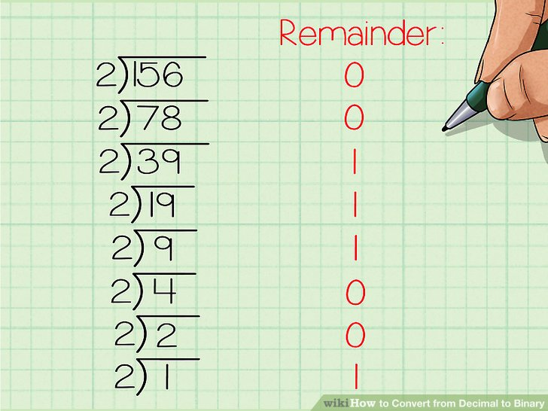
Number Systems And Conversions With Programs
We can represent numbers in following notations.
1.Binary. ( n base 2)
2.Octal. (n base 8)
3.Decimal.(n base 10)
4.Hexadecimal.(n base 16) here n = any number
1.Decimal to Binary Conversion:
Here for converting Decimal to Binary the manual method is to go on divide the given number by 2 .
The remainder will the Binary value of the given Decimal number.

Slide 231
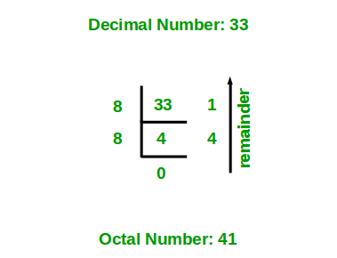
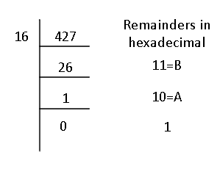
2.Decimal to Octal Conversion:
Here for converting Decimal to Octal the manual method is to go on divide the given number by 8 .
The remainder will the Octal value of the given Decimal number.
3.Decimal to Hex-Decimal Conversion:
Here for converting Decimal to Hex the manual method is to go on divide the given number by 16 .
The remainder will the Hex value of the given Decimal number.

Slide 232
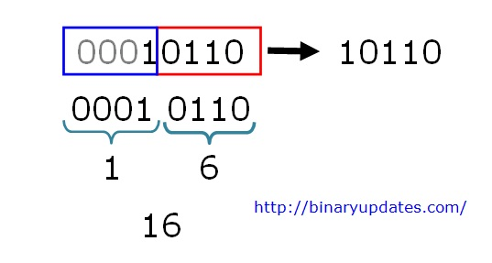
6. Binary to Hex Conversion:
Here for converting Binary to Octal the manual method is make a group of 4 digits of given Binary value.
And then repeat the same step of the Binary to Octal Conversion.

Slide 233
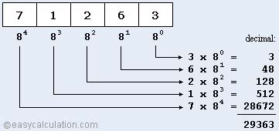
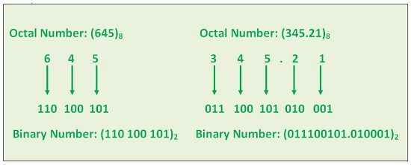
7.Octal to Decimal Conversion:
Here for converting Octal to Decimal the manual method is to go on powering(0 to n) the given Octal value by 8 .
At last to find Decimal value add the all powered value to obtain the Decimal number.
8.Octal to Binary Conversion:
Here for converting Octal to Binary the manual method is separate the given number into one one digit and find the Binary of each digit .
At last to write all Binary value serially to obtain the Binary number.

Slide 234
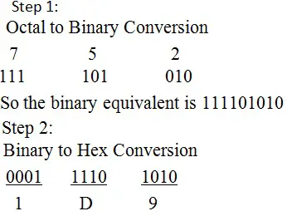
9.Octal to Hex-Decimal Conversion:
Here for converting Octal to Binary the manual method is first convert given number to Binary.
Then further convert that to Hex Decimal.

Slide 235
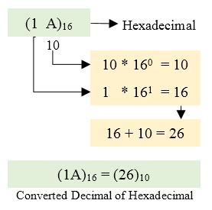
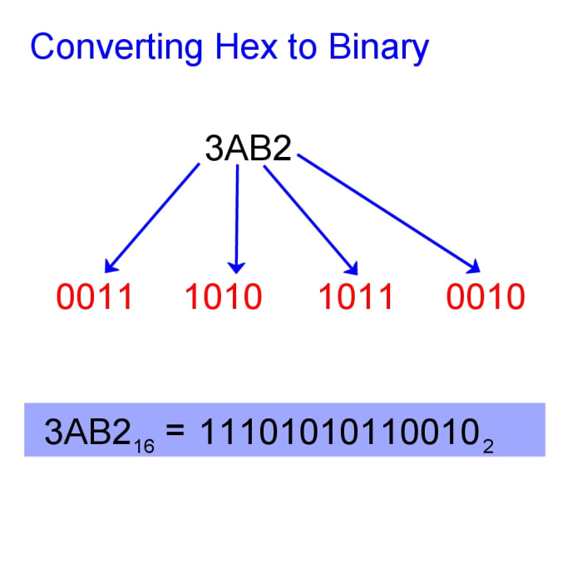
10.Hex-Decimal to Decimal Conversion:
Here for converting Hex to Decimal the manual method is to go on powering(0 to n) the given Binary value by 16.
At last to find Decimal value add the all powered value to obtain the Decimal number.
11.Hex-Decimal to Binary Conversion:
Here for converting Hex to Binary the manual method is separate the given number into one one digit and find the Binary of each digit .
At last to write all Binary value serially to obtain the Binary number.

Slide 236
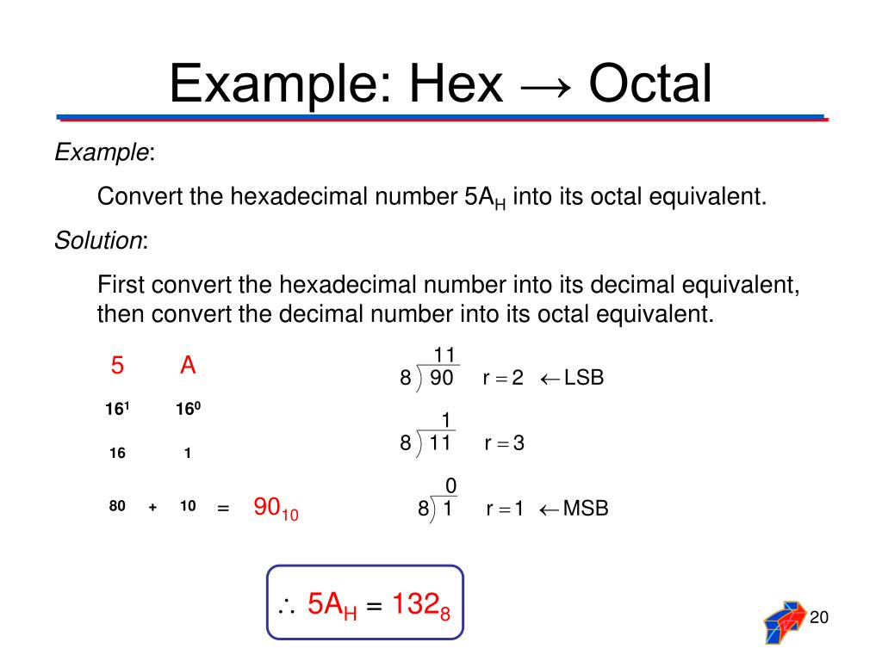
12.Hex-Decimal to Octal Conversion:
Here for converting Hex to Octal the manual method is first convert given number to Decimal.
Then further convert that to Octal.

Slide 237
Programs On Number System:
1.Converting Decimal To Binary:
#include <stdio.h>
void decToBinary(int n)
{
int binaryNum[32]; // array to store binary number
int i = 0; // counter for binary array
while (n > 0)
{
binaryNum[i] = n % 2; // storing remainder in binary array
n = n / 2;
i++;
}
for (int j = i - 1; j >= 0; j--) // printing binary array in reverse order
printf("%d", binaryNum[j]);
}
int main() // Driver program to test above function
{
int n ;
printf("Enter the decimal number:");
scanf("%d",&n);
decToBinary(n);
return 0;
}
Output:
Enter the decimal number:18
Binary value: 10010

Slide 238
2.Converting Octal to Decimal:
#include <stdio.h>
#include <math.h>
int OctalToDecimal(int num)
{
int x = 0;
int ans = 0;
while (num > 0)
{
int y = num % 10; // obtaining the right-most digit of num
num /= 10; // Since the right-most digits were previously scanned in the previous step, divide num by 10 to remove them.
ans += y * pow(8, x);
++x;
}
return ans;
}
int main()
{
int num;
printf("Enter Octal Number: ");
scanf("%d", &num);
printf("\n");
printf("Decimal Number is : %d", OctalToDecimal(num));
return 0;
}
Output:
Enter Octal Number: 32
Decimal Number is : 26

Slide 239
3.Converting Hex-decimal to Decimal:
#include <stdio.h>
#include <math.h>
#include <string.h>
#define ARRAY_SIZE 20
int main()
{
char hex[ARRAY_SIZE];
long long decimal = 0, base = 1;
int i = 0, value, length;
/* Get hexadecimal value from user */
printf("Enter hexadecimal number: ");
fflush(stdin);
fgets(hex,ARRAY_SIZE,stdin);
length = strlen(hex);
for(i = length--; i >= 0; i--)
{
if(hex[i] >= '0' && hex[i] <= '9')
{
decimal += (hex[i] - 48) * base;
base *= 16;
}
else if(hex[i] >= 'A' && hex[i] <= 'F')
{
decimal += (hex[i] - 55) * base;
base *= 16;
}
else if(hex[i] >= 'a' && hex[i] <= 'f')
{
decimal += (hex[i] - 87) * base;
base *= 16;
}
}
printf("\nHexadecimal number = %s", hex);
printf("Decimal number = %lld\n", decimal);
return 0;
}
Output:
Enter hexadecimal number: a
Hexadecimal number = a
Decimal number = 10

